Slide 1

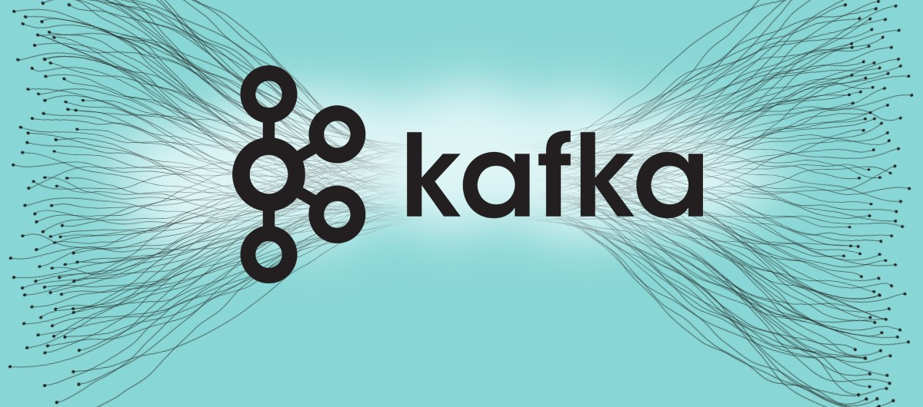
Module 7:
Data Streaming
- with Apache Kafka & Spark
Dr. Shanmugam Nandagopalan
shanmugamnandagopalan@mfu.ac.th

Slide 2
Agenda
Introduction to real-time data processing
What is Real-time Data Processing?
  Key Concepts and Definitions
  Importance and Applications
  Real-Time Data Architecture
  Data Streams and Event Processing
  Technologies and Tools
  Challenges and Solutions
Stream processing frameworks - Apache Kafka
Handling real-time data streams and event processing
Spark Streaming Demo

Slide 3
What is Real-time Data Processing?
Processing data instantly as it arrives.
Characteristics:
  Low latency
  High throughput
  Continuous processing
LinkedIn’s activity stream – Apache Kafka
Simon’s Use-Case: A wildlife monitoring system to observe population trends over time using a Raspberry Pi, along with Apache Kafka®, Kafka Connect, ksqlDB, TensorFlow Lite, and Kibana. He used the system to count animals in his Australian backyard and perform trend analysis on the results.

Slide 4
Introduction (Contd…)
Receive an alert when the temperature has reached the freezing point, querying data streams coming from a temperature sensor.
Other Use-cases:
    Smart Home automation
    Credit card fraud detection
    Hugh frequency trading
    Monitor the patient health continuously
Incremental computation vs. Batch computation
Speed layer vs. Batch layer

Slide 5
An Example
Suppose your data system receives 32 GB of new data per day (24 hours), and that new data gets into the serving layer within 6 hours of being received.
That is, 8 GB for every 6 hours.
Or, 8GB+ 8GB+ 8GB+ 8GB in 6+6+6+6 (=24 hours).
Running a function on 8 GB of data each time you receive a new piece of data will be extremely resource intensive.
Assume Average size of a data unit is = 100 byte
8 GB of recent data = 86 million data units
Processing time for 8GB data every 6 hours = 86,000,000 ✕ 8GB

Slide 6
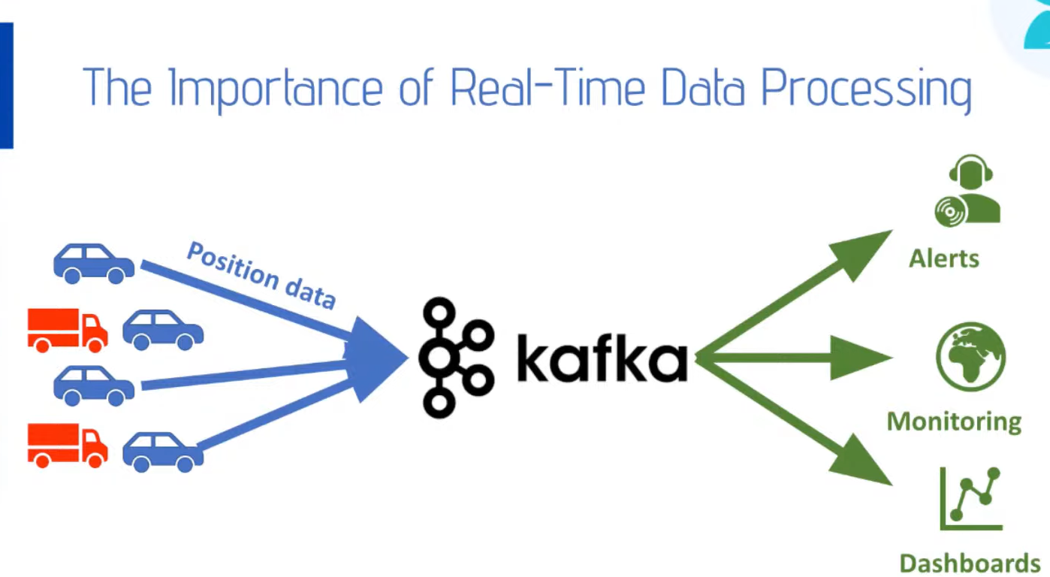
Another Example

Slide 7
Why is stream Processing needed?
Reason 1: Some data naturally comes as a never-ending stream of events.
To do batch processing, you need to store it, stop data collection at some time and processes the data.
Then you have to do the next batch and then worry about aggregating across multiple batches.
In contrast, streaming handles never ending data streams gracefully and naturally.
You can detect patterns, inspect results, look at multiple levels of focus, and also easily look at data from multiple streams simultaneously.
Example: traffic sensors, health sensors, transaction logs, activity logs, etc. Almost all IoT data are time series data.

Slide 8
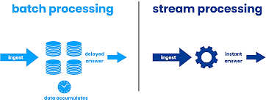
Contd…
Reason 2: Batch processing lets the data build up and try to process them at once while stream processing process data as they come in hence spread the processing over time.
Stream processing - less hardware than batch processing.
Enables approximate query processing via systematic load shedding.
Fits naturally into use cases where approximate answers are sufficient.

Slide 9
Contd…
Reason 3: Sometimes data is huge and it is not even possible to store it.
Can handle large fire horse style data and retain only useful bits.
Reason 4: lot of streaming data available (e.g. customer transactions, activities, website visits) and they will grow faster with IoT use cases (all kind of sensors).
More natural model to think about and program those use cases.

Slide 10
Use Cases
Traffic Monitoring, Geofencing, Vehicle, and Wildlife tracking — e.g. TFL London Transport Management System
Sports analytics — Augment Sports with real-time analytics
Context-aware promotions and advertising
Computer system and network monitoring
Predictive Maintenance, (e.g. Machine Learning Techniques for Predictive Maintenance)
Geospatial data processing
Algorithmic Trading, Stock Market Surveillance,
Smart Patient Care
Monitoring a production line
Supply chain optimizations
Intrusion, Surveillance and Fraud Detection e.g. Uber)
Most Smart Device Applications: Smart Car, Smart Home ..
Smart Grid — (e.g. load prediction and outlier plug detection see Smart grids, 4 Billion events, throughout in range of 100Ks)

Slide 11
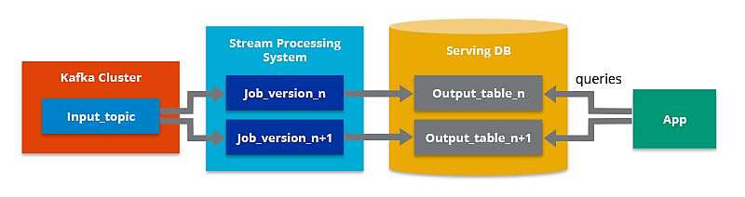
Stream Processing Architectures
Kappa Architecture
Kappa Architecture simplifies data processing by combining batch and real-time analytics into one.
Data enters a central data queue such as Apache Kafka and is converted into a format that can be directly fed into an analytics database.
By removing complexity and increasing efficiency, this unified method enables you to analyze data more quickly and instantly obtain deeper insights.

Slide 12
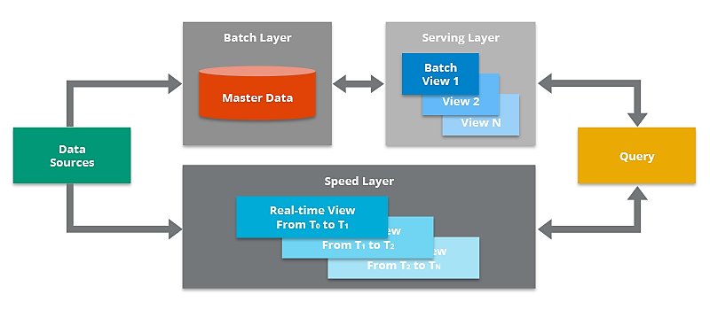
Lambda Architecture
It blends real-time stream processing for instant insights with conventional batch processing for historical analysis.
Enterprises may see all aspects of their data, from quick changes to long-term patterns.
Elements: batch pipeline for historical data analysis, a streaming pipeline for real-time data acquisition and processing.

Slide 13
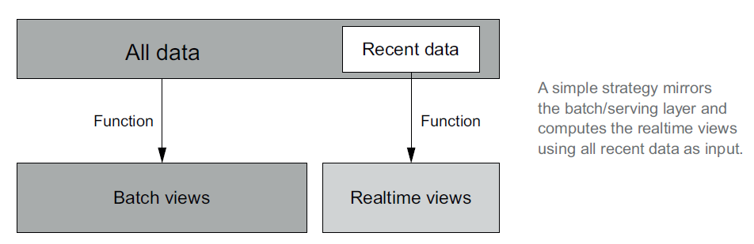
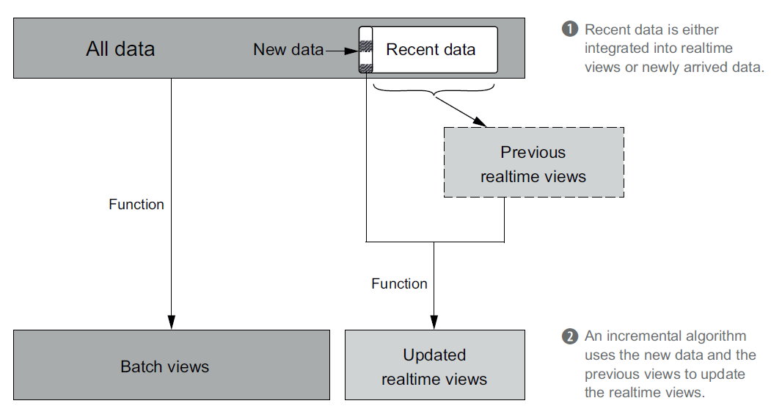
A simple Solution
Rather than compute functions
on your entire dataset, you instead compute using more complex incremental algorithms on more complex forms
of storage.
Incremental strategy

Slide 14
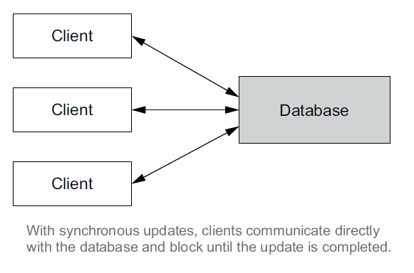
Speed Layer Architecture
Asynchronous versus synchronous updates
synchronous updates : the application issues a request directly to the database and blocks until the update is processed.
For example, if a user registers an email address, you may choose to issue a synchronous update to the database to record the new information. It’s faster.

Slide 15
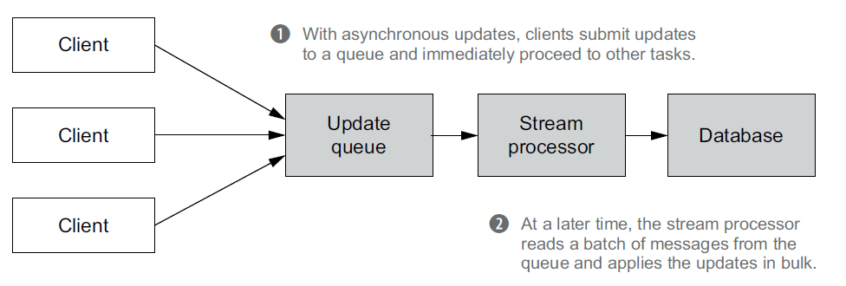
Asynchronous Updates
Asynchronous update requests are placed in a queue with the updates occurring at a later time.
In the speed layer, this delay is from a few milliseconds to a few seconds, but it could take even longer if there’s an excess of requests.

Slide 16
Distributed Messaging Architecture: Apache Kafka
Apache Kafka - distributed messaging system.
Storm - distributed stream processing engine.
Any messaging system has three major components; the message producer, the message consumer, and the message broker.
In point-to-point paradigm, the producer of the messages sends the messages to a queue.
The message broker is the heart of the whole messaging system, which bridges the gap between the producer and consumer.
A “durable message” is a message where the broker will hold on to a message if the subscriber is temporarily unavailable.

Slide 17
Contd…
Keeping the state of the message (whether message is consumed or not) is a tricky problem.
How Broker and Consumer conclude that a given message is consumed.
Can a broker mark a message consumed as and when it put the message in the network for delivery?
What will happen if the Consumer is down by the time the message reaches the consumer?
To solve this, most messaging systems keep an acknowledgement system. When a message is delivered by a broker, it is marked as “sent”, and when the consumer consumes the message and sends an acknowledgement, the broker marks it as “consumed”.
But what will happen if the consumer actually consumed the message, but a network failure occurred before the acknowledgement reached the broker? The broker will still keep the state as “sent” not “consumed”.

Slide 18
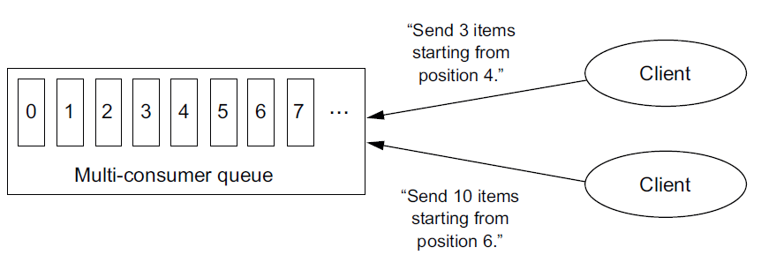
Queuing and Stream Processing
Multi-consumer queues: If an application keeps track of the consumed events, it can then request the event stream to be replayed from any point in the stream history.
With a multi-consumer queue, applications request specific items from the queue and are responsible for tracking the successful processing of each event, E.g. Apache Kafka

Slide 19
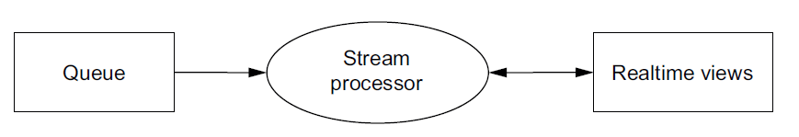
Stream Processing
Once you have your incoming events feeding your multi-consumer queues, the next step is to process those events and update your realtime views.
Two models: one-at-a-time and microbatched.

Slide 20
One-at-a-time stream processing
Storm model: The Storm model represents the entire stream-processing pipeline as a graph of computation called a topology.
Queues-and-workers schemes: write separate programs for each node of the topology and connect them manually.
Storm model: involves a single program that’s deployed across a cluster.
A single executable to filter data in one node, compute aggregates with a second node, and update real time view databases with a third.

Slide 21
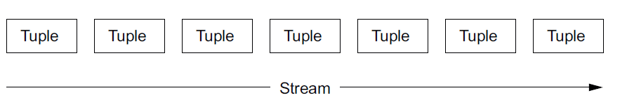
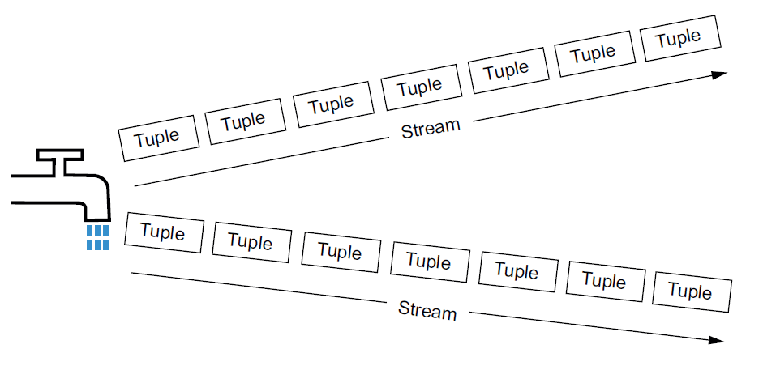
Storm Model
The core of the Storm model are streams.
A stream is an infinite sequence of tuples.
A tuple is simply a named list of values.
A spout is a source of streams in a topology

Slide 22
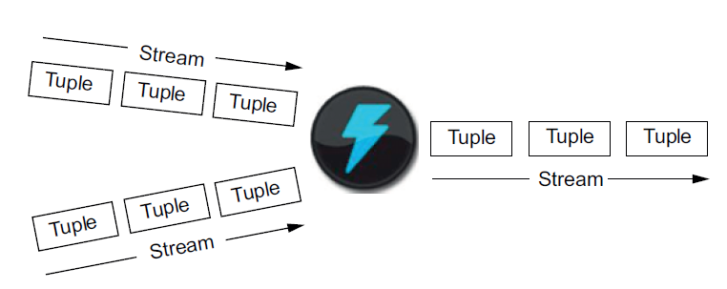
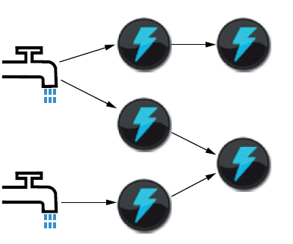
Bolt Abstraction
The bolt abstraction performs actions on streams.
A bolt takes any number of streams as input and produces any number of streams as output.
A topology connects spouts and bolts and defines how tuples flow through a Storm application.
Each instance of a spout or bolt is called a task.

Slide 23
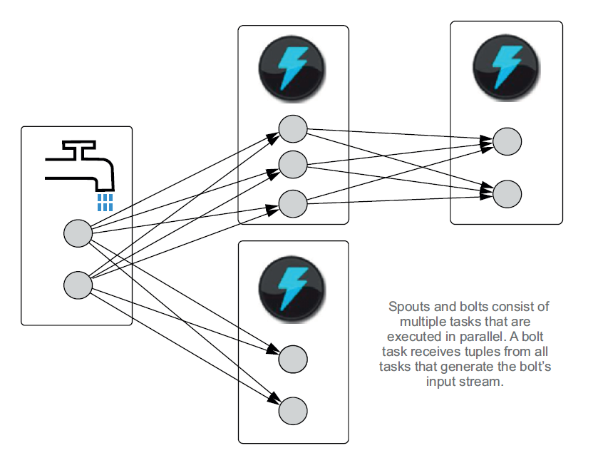
Task Execution
In a topology, the spouts and bolts have multiple instances running in parallel.

Slide 24
Apache Kafka

Slide 25
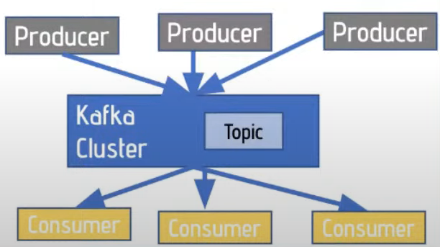
What is Kafka?

Slide 26
Apache Kafka – an Introduction
Kafka combines three key capabilities:
To publish (write) and subscribe to (read) streams of events, including continuous import/export of your data from other systems.
To store streams of events durably and reliably for as long as you want.
To process streams of events as they occur or retrospectively.

Slide 27
Main Concepts
An event records the fact that "something happened" in the world or in your business. It is also called record or message in the documentation.
When you read or write data to Kafka, you do this in the form of events.
Conceptually, an event has a key, value, timestamp, and optional metadata headers. Here's an example event:
  Event key: "Alice"
  Event value: "Made a payment of $200 to Bob"
  Event timestamp: “Oct, 25, 2024 at 2:06 p.m.

Slide 28
Contd…
Producers are those client applications that publish (write) events to Kafka.
Consumers are those that subscribe to (read and process) these events.
In Kafka, producers and consumers are fully decoupled.
For example, producers never need to wait for consumers.
Events are organized and durably stored in topics.
Topic is similar to a folder in a filesystem, and the events are the files in that folder.

Slide 29
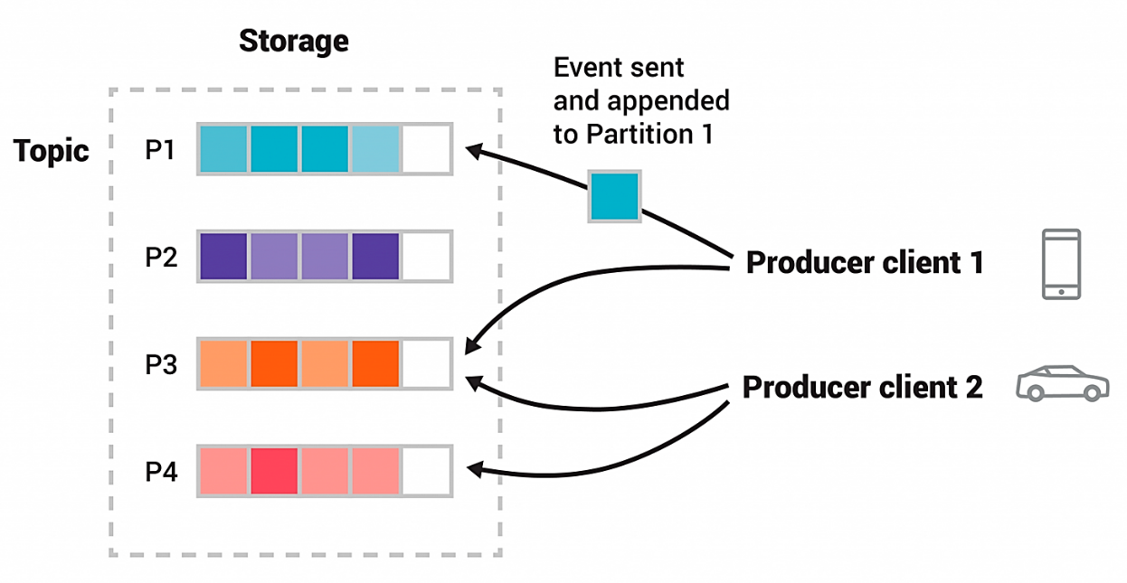
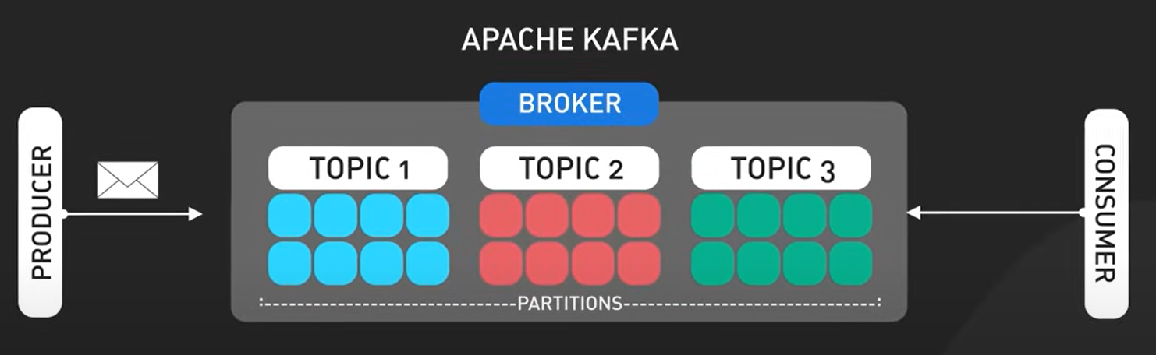
Example
Topics are partitioned, meaning a topic is spread over a number of "buckets" located on different Kafka brokers.
When a new event is published to a topic, it is actually appended to one of the topic's partitions.
Events with the same event key (e.g., a customer or vehicle ID) are written to the same partition.

Slide 30
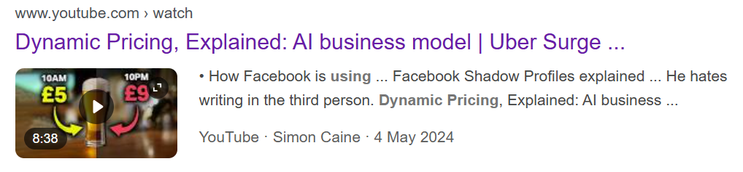
Dynamic Pricing
https://youtu.be/gYoTw2LaaKI?si=sG0QDJKoUoTfIhPU

Slide 31
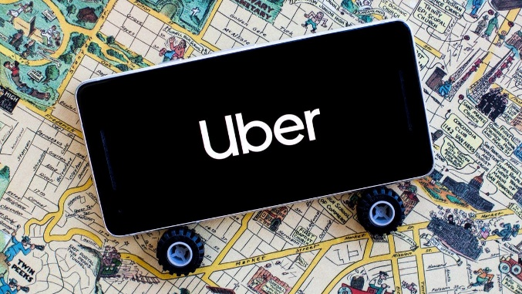
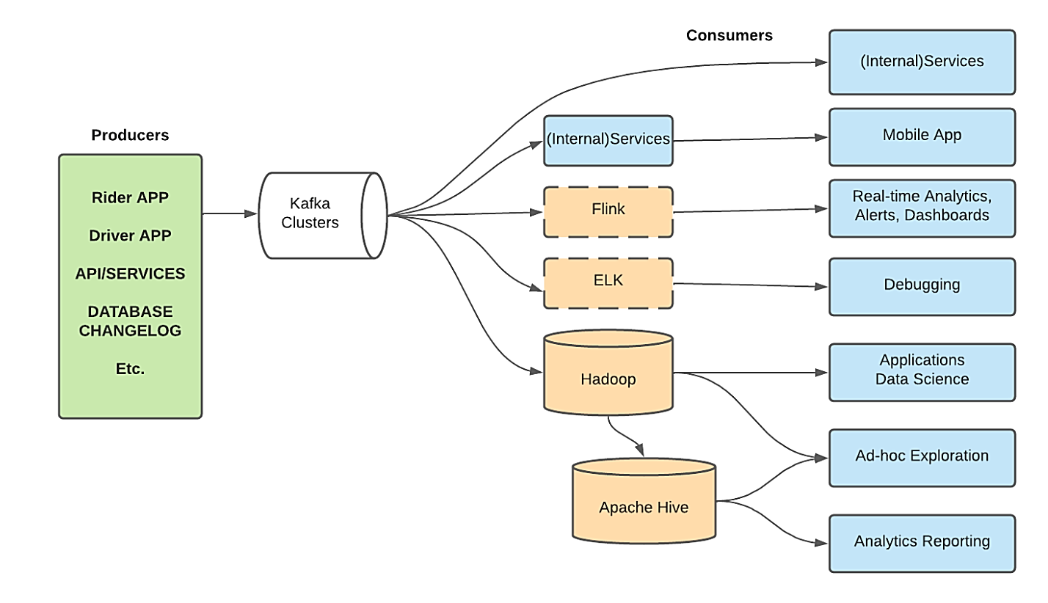
Uber’s Architecture using Kafka
Dynamic pricing is essential for Uber to maintain an equilibrium between ride demand and driver supply.
Producers:
Rider app, Driver app, API, DB, other sources (weather, traffic, etc.)
Consumers:
API, Mobile App, Apache Flink (real-time data analytics), Elasticsearch, Hadoop, etc.

Slide 32
Real-Time Surge Pricing
Data Collection: As soon as a rider opens the app and requests a ride, data about the request is sent to Kafka. Simultaneously, data from drivers in the area, including their availability and location, is also sent to Kafka.
Data Ingestion: Kafka ingests this data in real-time and makes it available to various consumers.
Processing with Flink: Apache Flink processes the incoming data streams to identify patterns, such as an unusually high number of ride requests in a specific area.
Triggering Surge Pricing: Based on the analysis, if demand significantly exceeds supply, Flink triggers an alert to adjust the pricing. This information is immediately sent back to Kafka.
Updating Mobile Apps: The updated pricing is then consumed by the internal services responsible for the rider and driver apps. Riders see the new surge price, and drivers are notified of increased earnings potential in high-demand areas.
Continuous Monitoring: The system continuously monitors the data to ensure that prices remain optimal as conditions change. If more drivers enter the high-demand area and balance the supply-demand ratio, the surge pricing is reduced or removed.

Slide 33
Producers and Consumers
Producers:
Rider app, Driver app, API, DB, other sources (weather, traffic, etc.)
Consumers:
API, Mobile App, Apache Flink (real-time data analytics), Elasticsearch, Hadoop, etc.

Slide 34
Apache Kafka Demo

Slide 35
Running Kafka
1. Start Zookeeper process from C:\kafka folder
c:\kafka>.\bin\windows\zookeeper-server-start.bat .\config\zookeeper.properties
2. Start kafka Server
C:\kafka>.\bin\windows\kafka-server-start.bat .\config\server.properties
3. Create a topic from C:\kafka\bin\windows
C:\kafka\bin\windows>kafka-topics.bat --create --bootstrap-server
localhost:9092 --topic test
Created topic test.
4. Start a Producer
C:\kafka\bin\windows>kafka-console-producer.bat --broker-list localhost:9092 --topic test
5. Start a Consumer
C:\kafka\bin\windows>kafka-console-consumer.bat --topic test --bootstrap-server localhost:9092 -from-beginning

Slide 36
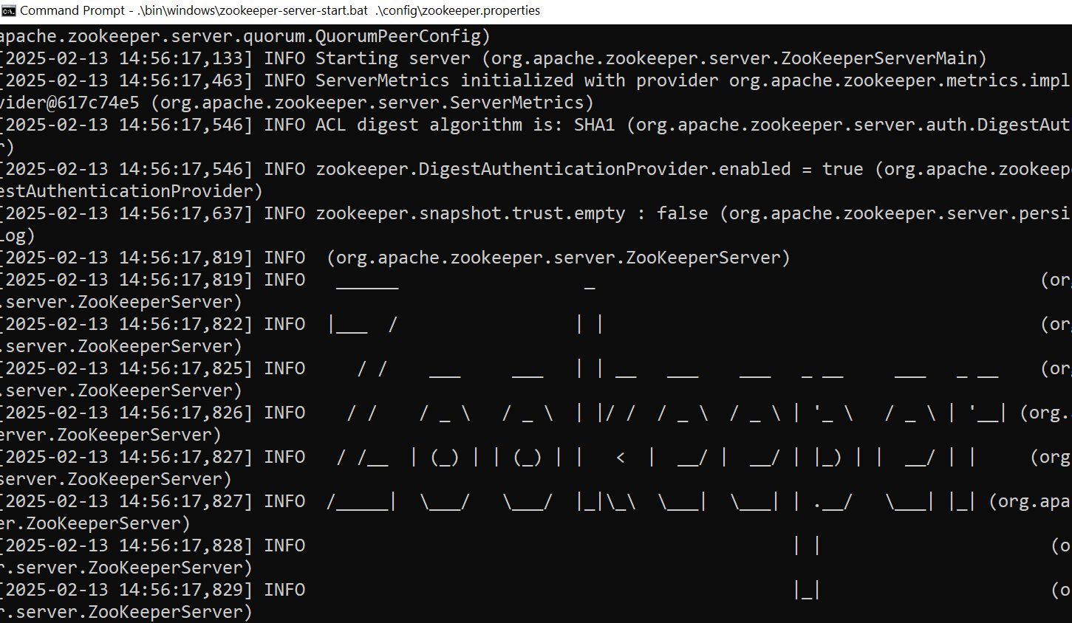
Start Zookeeper Server

Slide 37
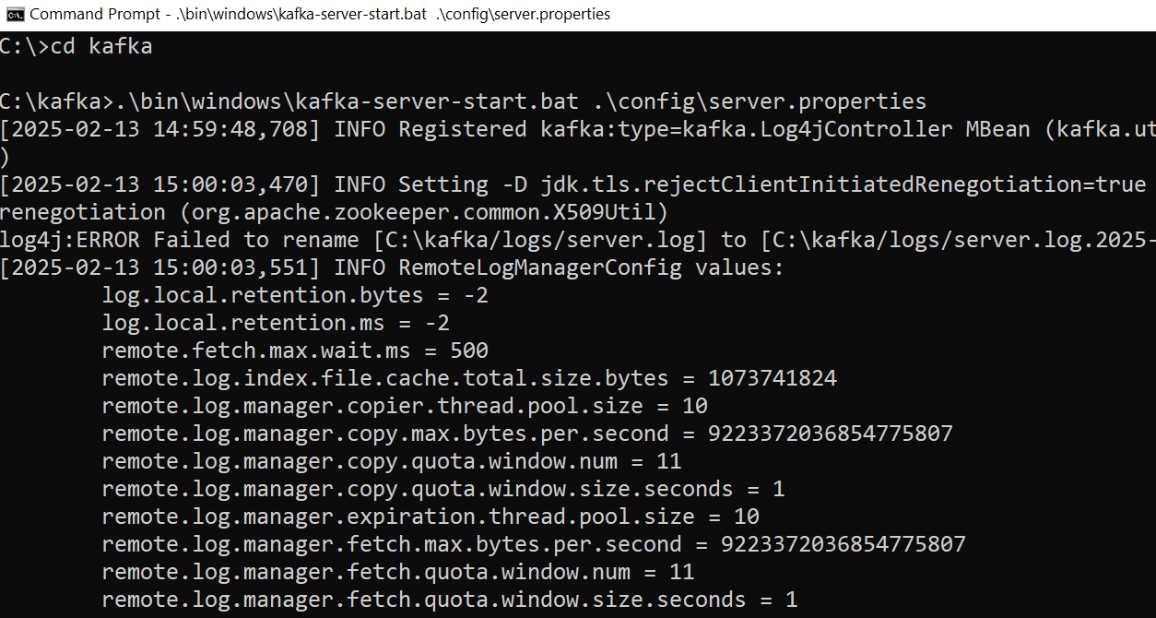
Start Kafka Server

Slide 38
Create a Topic – “test”

Slide 39
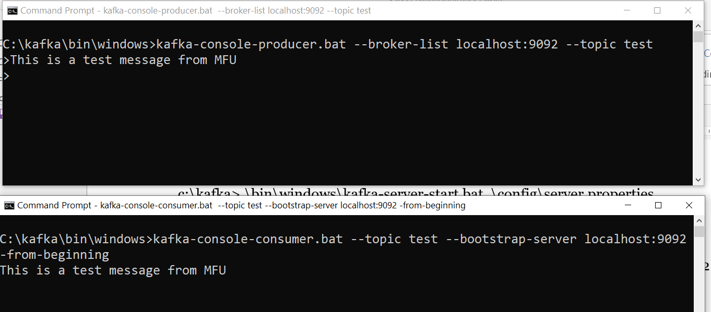
Producer & Consumer
Producer
Consumer

Slide 40
Test Producer & Consumer - ingesting data:
From Producer window push a JSON/any text data:
C:\kafka\bin\windows>kafka-console-producer.bat --broker-list localhost:9092 --topic test
>{"Name: "John", "Age":"31", "Gender":"Male"}
Check it in Consumer Window:
C:\kafka\bin\windows>kafka-console-consumer.bat --topic test --bootstrap-server localhost:9092 -from-beginning
{"Name: "John", "Age":"31", "Gender":"Male"}

Slide 41
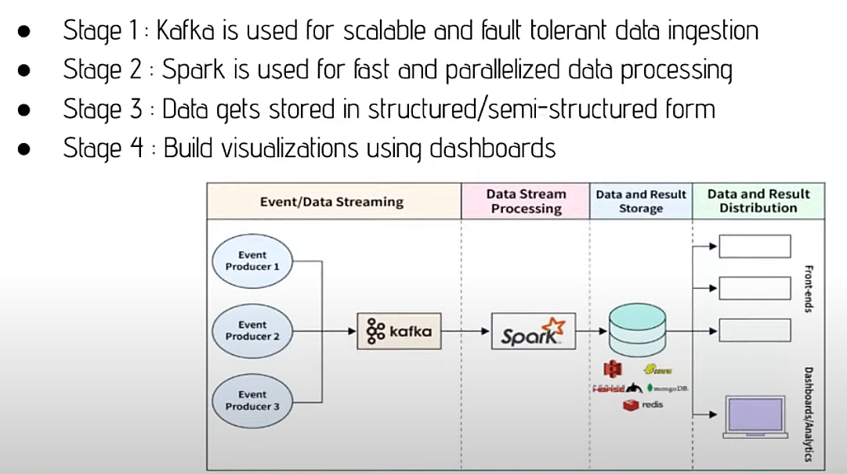
Integration of Kafka & Spark

Slide 42
Code
Cell-1:
# To produce messages programmatically and send to the Consumer
from pyspark.sql.functions import *
from pyspark.sql.types import *
from pyspark.sql import SparkSession
from kafka import KafkaProducer
import json
# Initialize Spark Session with Kafka dependencies
spark = SparkSession.builder \
.appName("KafkaStructuredStreaming") \
.master("local[*]") \
.config("spark.jars.packages", "org.apache.spark:spark-sql-kafka-0-10_2.12:3.4.0") \
.config("spark.sql.streaming.checkpointLocation", "file:///C:/tmp/kafka-checkpoint") \
.getOrCreate()
spark

Slide 43
Code…
Cell 2:
kafka_df = spark.readStream \
.format("kafka") \
.option("kafka.bootstrap.servers", "localhost:9092") \
.option("subscribe", "test") \
.option("startingOffsets", "latest") \
.load()

Slide 44
Code…
Cell-3:
from datetime import datetime
# datetime object containing current date and time
now = datetime.now()
# dd/mm/YY H:M:S
dt_string = now.strftime("%d/%m/%Y %H:%M:%S")
# Create a Kafka producer and
# Serialize JSON data
producer = KafkaProducer(
bootstrap_servers='localhost:9092',
value_serializer=lambda v: json.dumps(v).encode('utf-8'))
# Sample data (10) to send to the Consumer
id = 1
for i in range (10):
msg = dt_string + " Hello Kafka Message No. " + str(i)
data = {"id": i, "message": msg }
# Send the JSON message
producer.send("test", value=data)
producer.flush() # Ensure all messages are sent
print("Message sent successfully!")

Slide 45
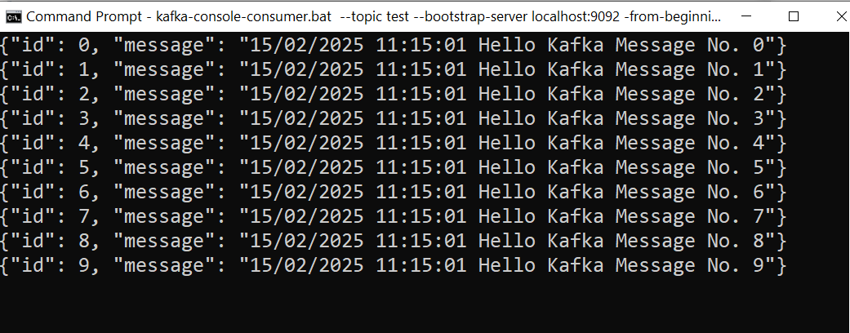
Consumer Window

Slide 46
Thank You

